Slide 1

John Mitchell, Department of Targeted Intervention, Division of Surgery

Slide 2

Compositional Data Analysis of 24-hour Movement Data
John Mitchell

Slide 3
Covered:
Fundamentals of CODA: What is a composition?
Why to use CODA?
Implementation in R
Extensions of CODA.
Reflections/reviewer pitfalls!
R Code

Slide 4
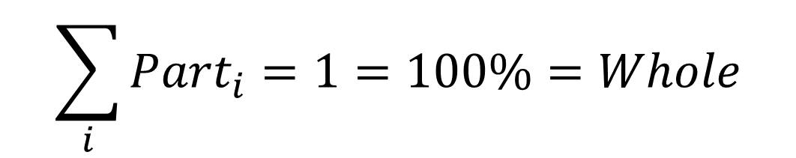
Compositional Data Analysis
Established statistical methodology adapted for analyses with co-dependent parts such as in the earth sciences. e.g. Exploring mineral content of rocks.
$$\sum_{i}{{Part}_{i}}=1=100\%=Whole$$

Slide 5
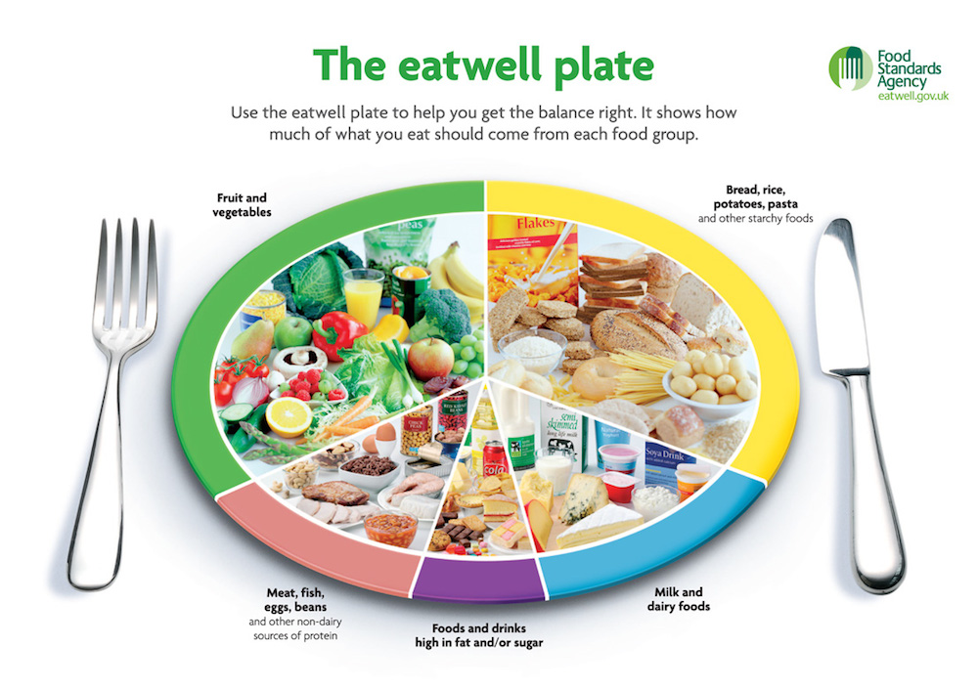
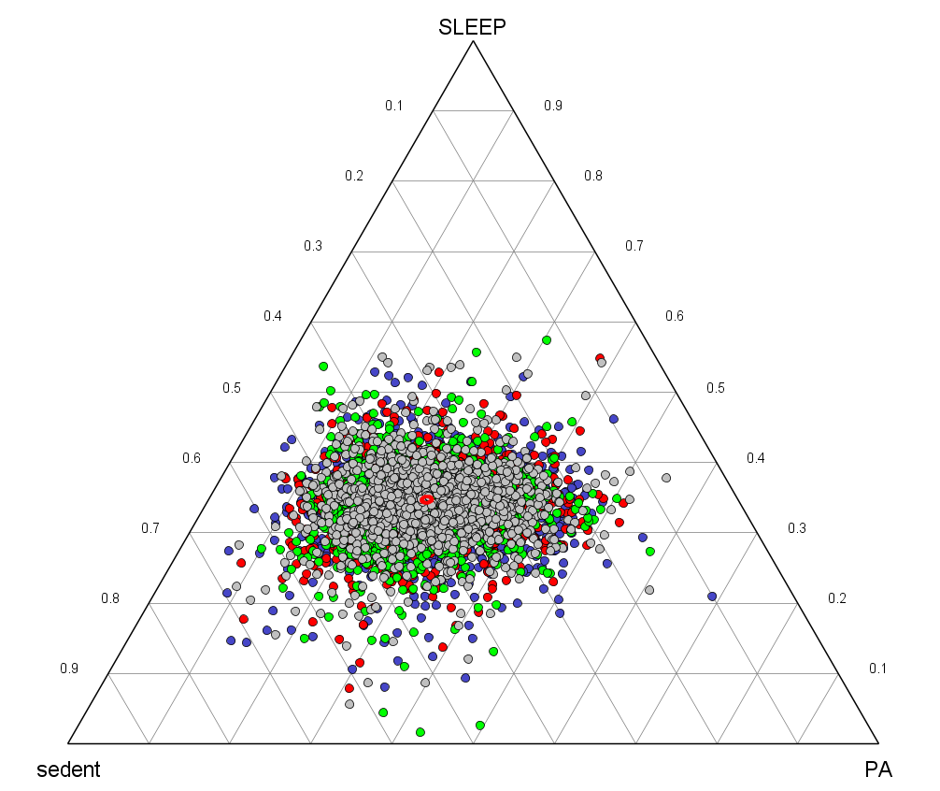
Absolute vs Relative Data
Distinguishes absolute from relative data.
Step count, TDEE, consumption are absolute quantities with no clear/only a theoretical limit.
Daily movement, cocktail ingredients, average meal, daily nutrition consumption are all relative quantities, and are “bounded”.

Slide 6
What’s the problem?
Consider participant time use, nutrition, typical food compositions, as infinite quantities.
For instance, sedentary behaviour can continue indefinitely while reported MVPA doesn’t necessarily change…
(In mathematics, this is a problem of geometry..
most summary and inferential statistics compare
the Euclidian distance between samples,
but compositional data would be incorrectly
represented in Euclidian space).
Inactive
16 hours
8 hours
9 hours
Active

Slide 7
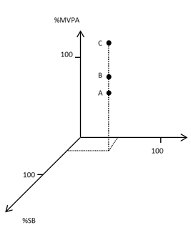
Most statistical measures/methods assume data belonging to Euclidean space
Common basic statistics such as the arithmetic mean and variance implicitly assume that the Euclidean distance (d_{e}) is a suitable measure of difference between two observations.
BUT ……..

Slide 8
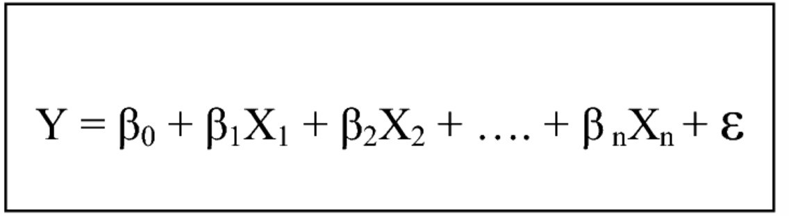
Classical Approach: assumes it’s Absolute
Typical Leave one out’ regression approach
Model 1
Model 2
Leads to incorrect interpretation of the coefficients of regressions.
Issues of multicollinearity
Doesn’t adjust for ~necessary change in the other co-dependent components which affect this relationship.
Y = β₀ + β₁ (MVPA) + β₂ (SB) + ε
Y = β₀ + β₁ (MVPA) + β₂ (LIPA) + ε

Slide 9
Relative data deserve relative thinking: Raw totals aren’t always relevant.
Sometimes total is irrelevant to the bigger picture: e.g. size of the rock sample, size of the overall population.
Amounts may be incompletely given and don’t sum to the whole: like a sample: ‘e.g. device wear time varies between participants. E.g. a blood sample.

Slide 10
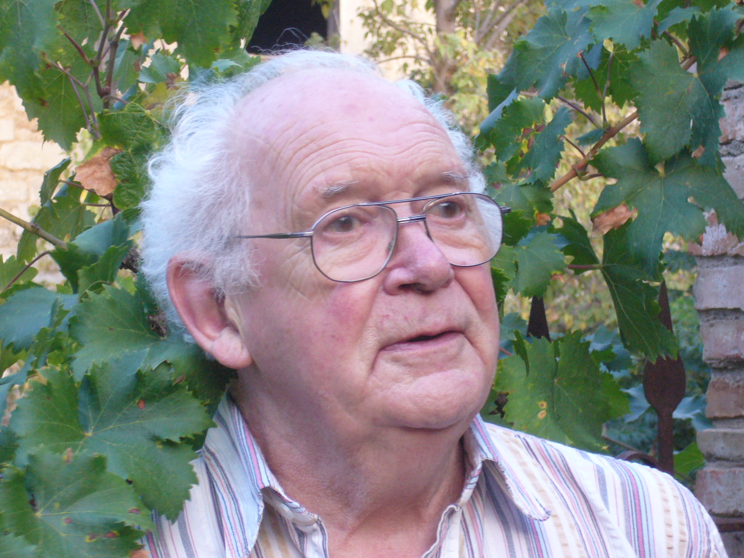
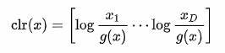
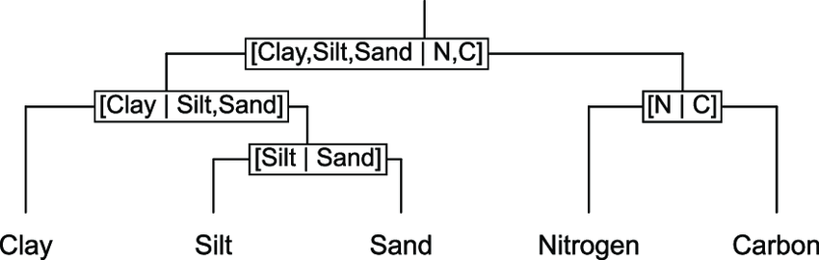
Aitchison (1986)
Complex methodologies for modelling compositional analysis.
Compositions should always be treated on a ‘Log-ratio-transformed scale’.
Many log-ratio transformations.. E.g. (mean)-centred lr

Slide 11
Aitchison (1986)
Complex methodologies for modelling compositional analysis.
Compositions should always be treated always on a ‘Log-ratio-transformed scale’.
Many log-ratio transformations.. E.g. (mean)-centred lr
..Please don’t ask me questions here.

Slide 12

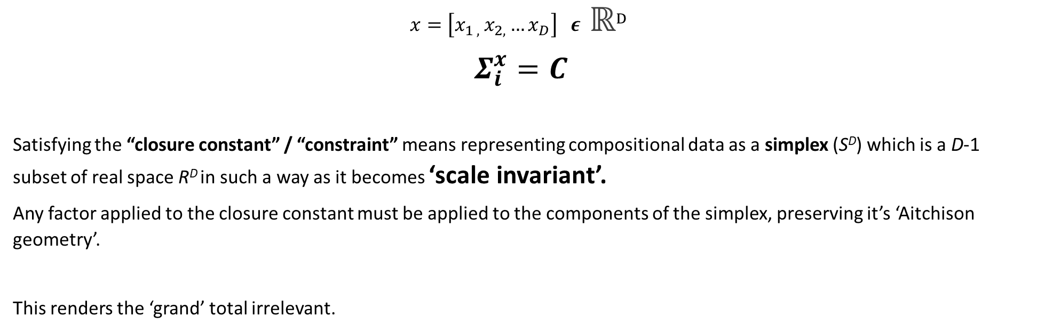
Professor Pawlowsky-Glahn “Vector Spaces” & “Aitchison Geometry”
$$x=\left[x_{1 , }x_{2, }…x_{D}\right] ε ℝ^{D}$$
$$Σ_{i}^{x}=C$$
Satisfying the “closure constant” / “constraint” means representing compositional data as a simplex (S^{D}) which is a D-1 subset of real space R^{D} in such a way as it becomes ‘scale invariant’.
Any factor applied to the closure constant must be applied to the components of the simplex, preserving it’s ‘Aitchison geometry’.
This renders the ‘grand’ total irrelevant.
Notes:
X (A composition is some subset of real space, tiny or large)
Sum of x’s components equals some closure constant (Sum)

Slide 13


Professor Pawlowsky-Glahn: “Vector Spaces” & “Aitchison Geometry”
$$x=\left[x_{1 , }x_{2, }…x_{D}\right] ε ℝ^{D}$$
$$Σ_{i}^{x}=C$$
Satisfying the “closure constant” / “constraint” means representing compositional data as a simplex (S^{D}) which is a D-1 subset of real space R^{D} in such a way as it becomes ‘scale invariant’.
Any factor applied to the closure constant must be applied to the components of the simplex, preserving it’s ‘Aitchison geometry’.
This renders the ‘grand’ total irrelevant.
..Please don’t ask me questions here.
Notes:
X (A composition is some subset of real space, tiny or large)
Sum of x’s components equals some closure constant (Sum)

Slide 14
…A solution through geometry

Slide 15
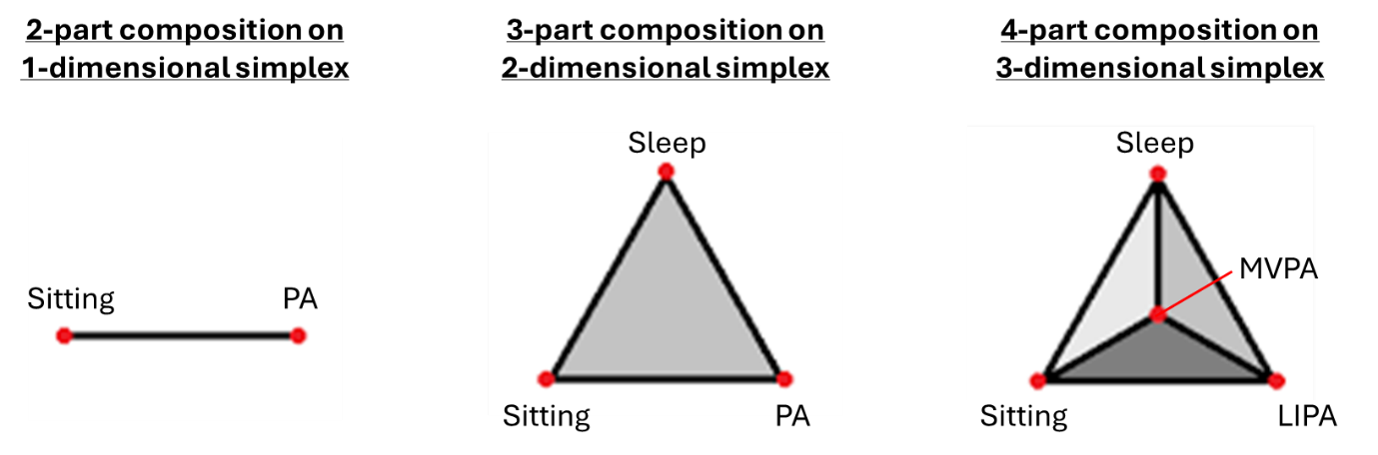
Simplexes
Represent d-components on a d-1 Simplex.
The simplex representation of compositions means that as time in one component of daily movement changes, one or other components must show an equal and opposite change in their total. They collapse compositions of D dimensions into a D-1 “simplex space”.
Again, this is all achieved for you by the upcoming ‘transformations” implemented in R.
Notes:
The simplex representation of compositions means that as time in one component of daily movement changes, one or other components must show an equal and opposite change in their total. They collapse compositions of D dimensions into a D-1 “simplex space”.
This is achieved by representing 2-part compositions in a 1-dimensional simplex, 3-part compositions in a 2-dimensional simplex, or a 4-part composition in a 3-dimensional simplex.

Slide 16
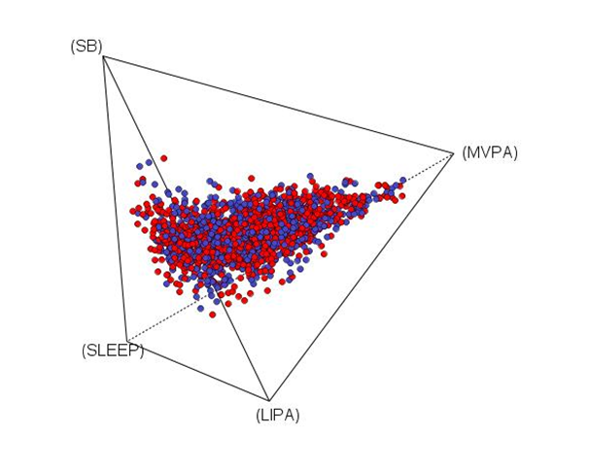
In summary - converting data into the simplex space (achieved by the log-transformations) means:
The sum total becomes irrelevant.
The data are scale invariant.
A change in one component has appropriate penalty for other component(s).

Slide 17
Part II: Implementation in R

Slide 18
Prep
Apply closure constant
Visualisation
Modeling
Apply log-ratio transformation
Substitution
Adjust movement behaviours min-by-min
Model, re-pivot, model ...
Re-transform
Predict

Slide 19
Prep
Apply closure constant
Visualisation
Modeling
Apply log-ratio transformation
Substitution
Adjust movement behaviours min-by-min
Model, re-pivot, model ...
Re-transform
Predict

Slide 20
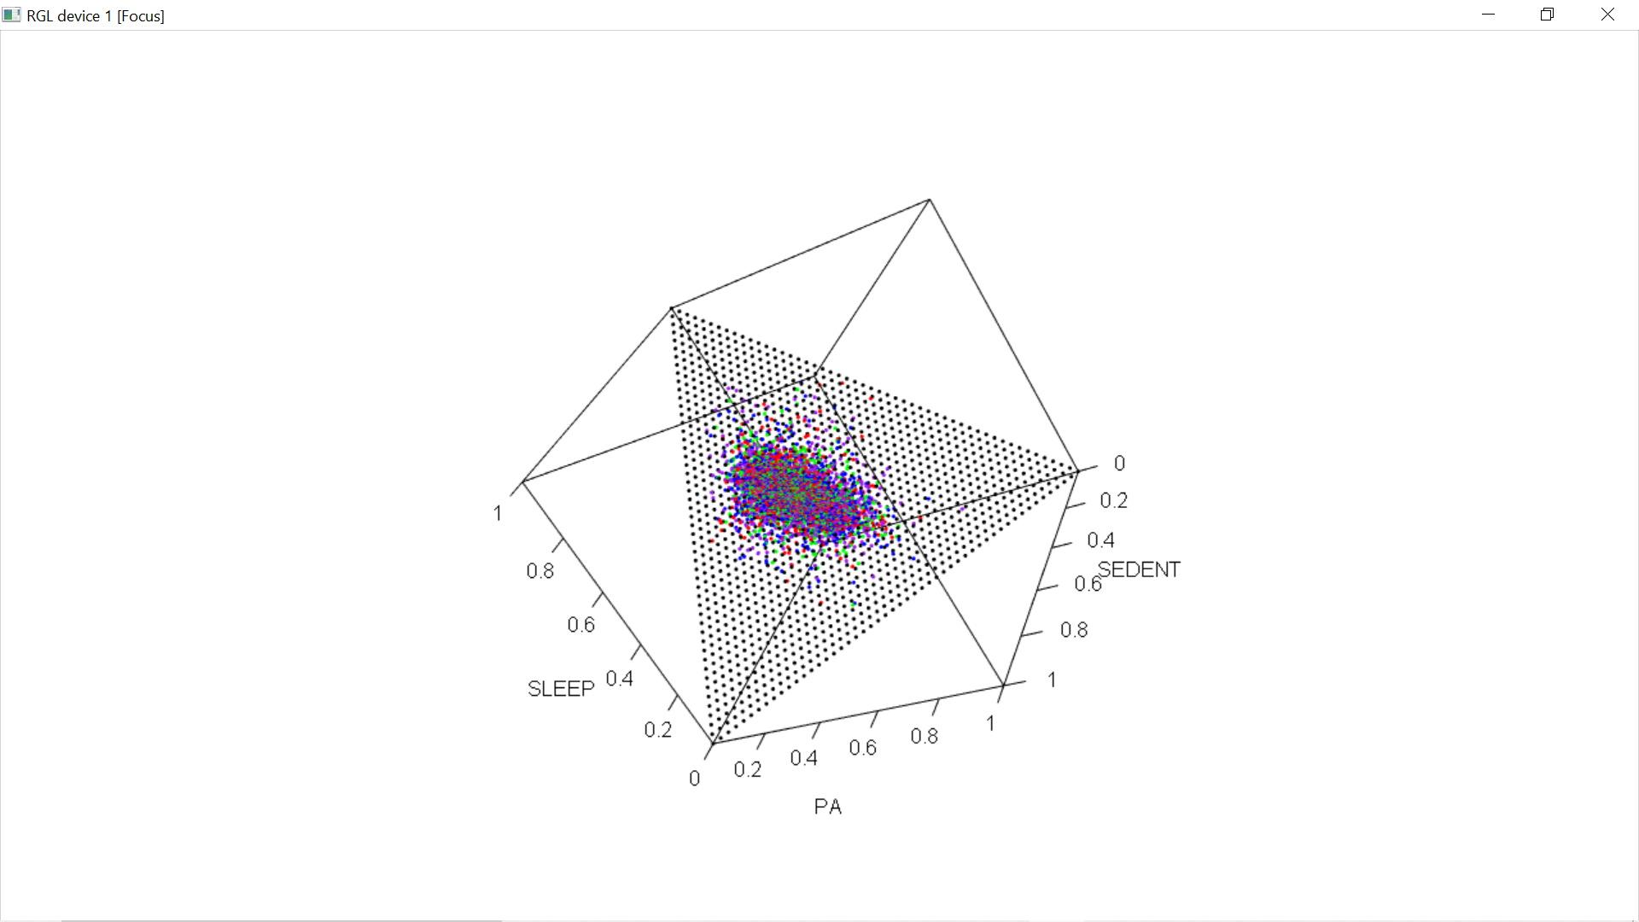
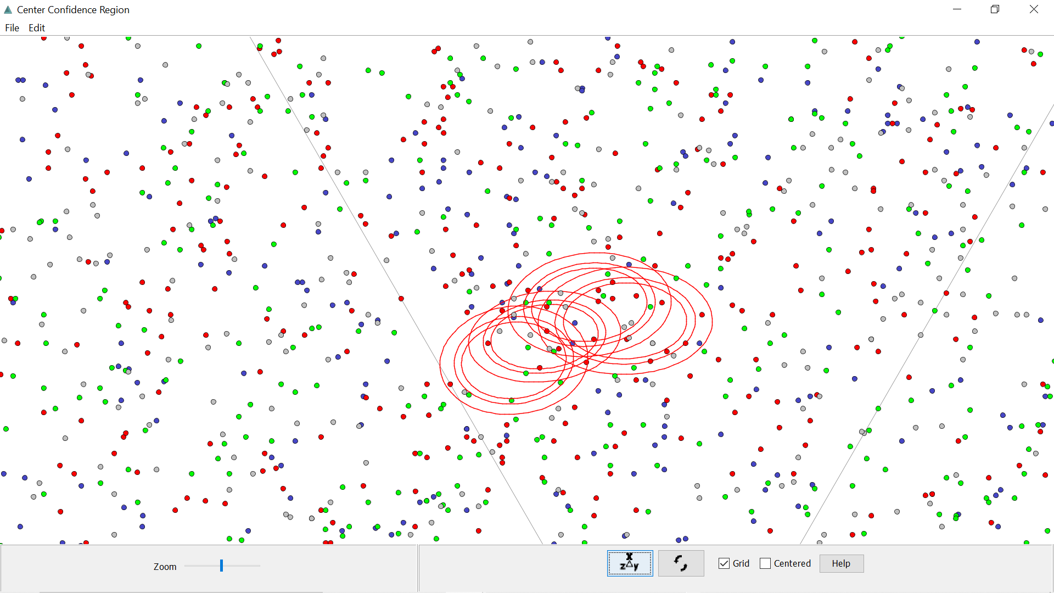
Resources – Codapack

Slide 21
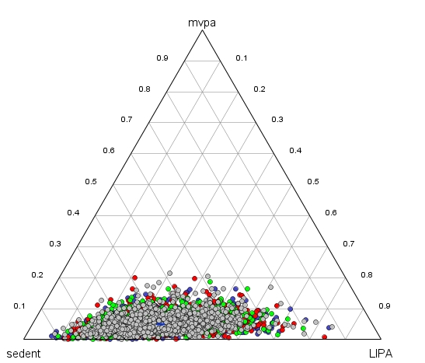
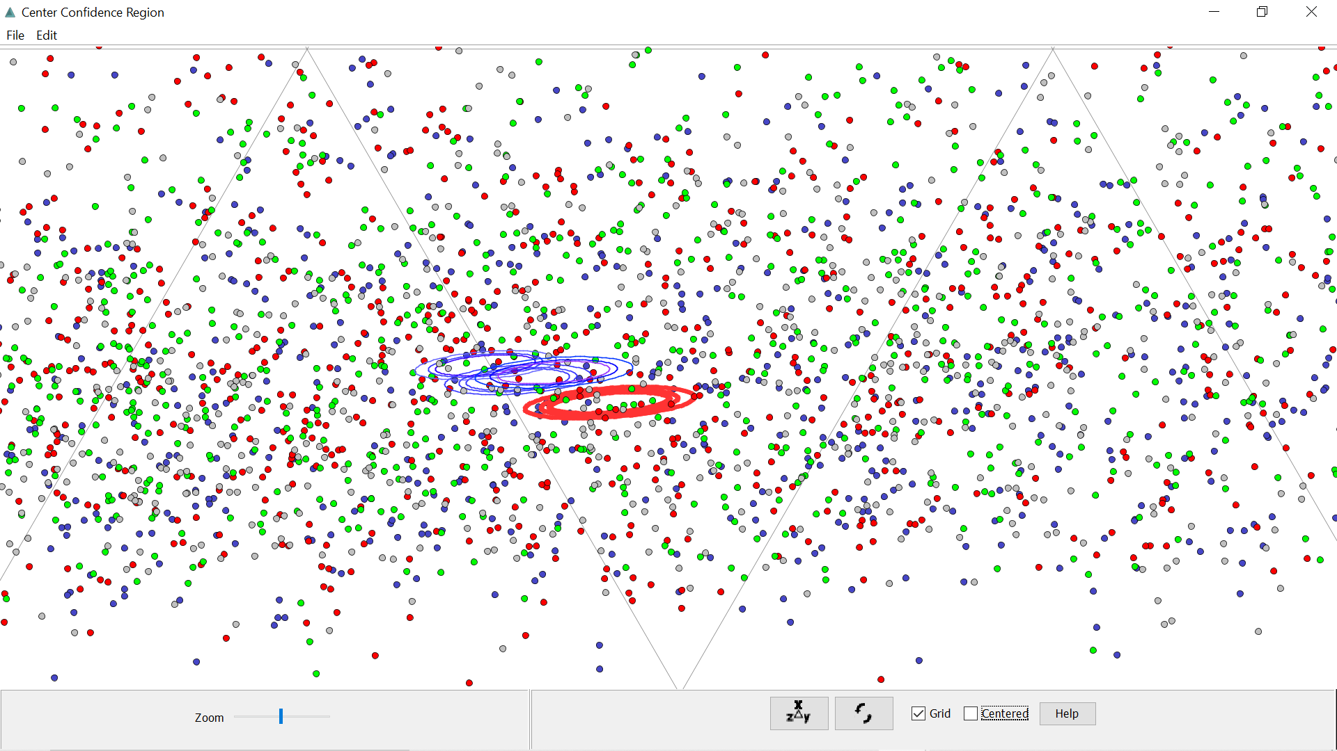
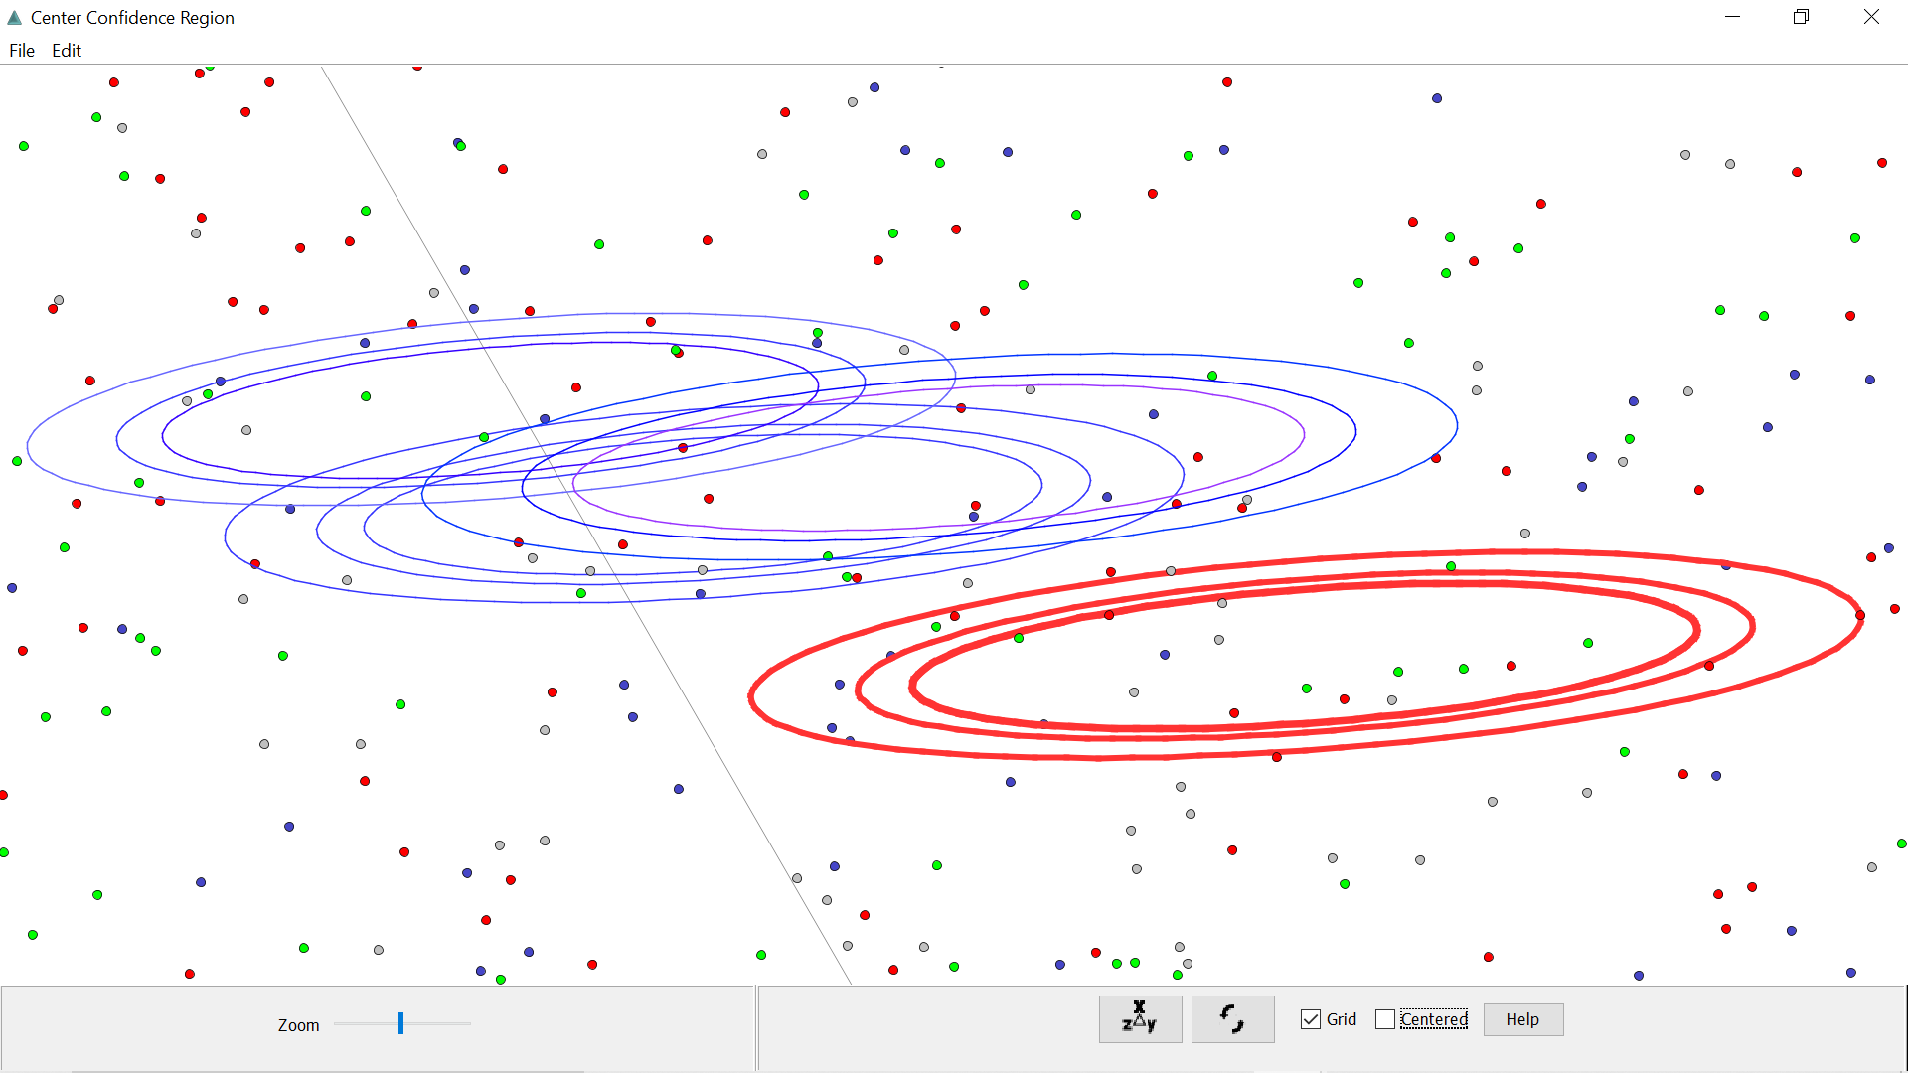
YASSS

Slide 22
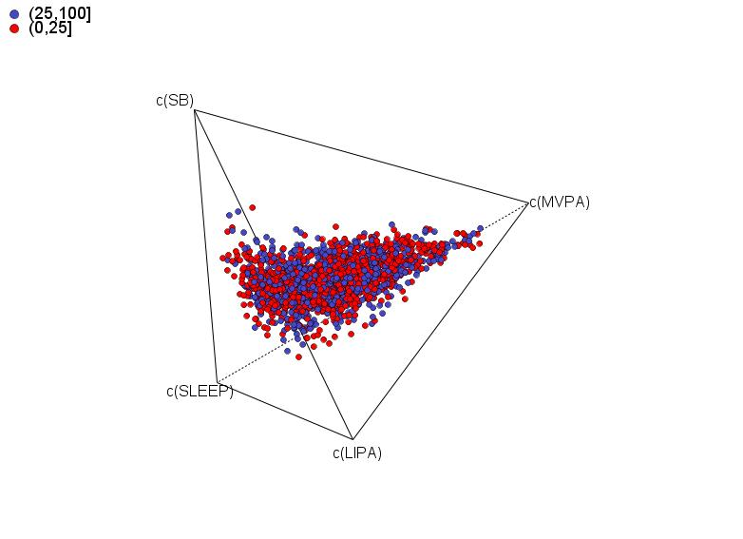
Totals
data$BMI: (0,25]
SB LIPA MVPA SLEEP
9.4012854 7.0608918 0.5806844 6.9571429
---------------------------------------------------------------------------------------
data$BMI: (25,100]
SB LIPA MVPA SLEEP
9.7494291 7.0280280 0.4949372 6.7276038

Slide 23
Ternary plots vs Log-ratio difference Plot
(Reference: Mean composition)
Log(MVPA_{group}/MVPA_{pop})

Slide 24

Totals
Log Ratios

Slide 25
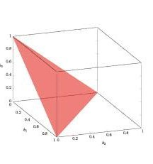
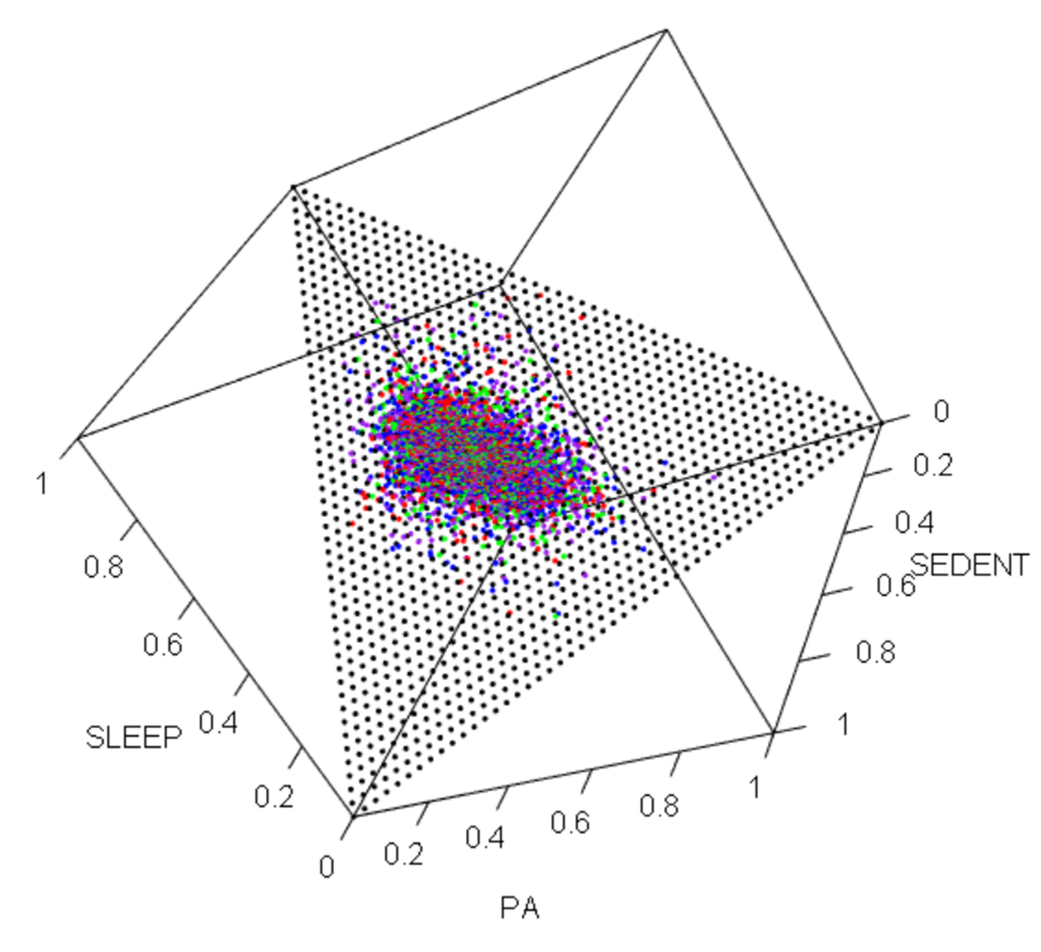
Plotting closed vector spaces as a simplex: (3 components: 2D simplex)

Slide 26
Plotting closed vector spaces as a simplex (4 components: 3D simplex)

Slide 27

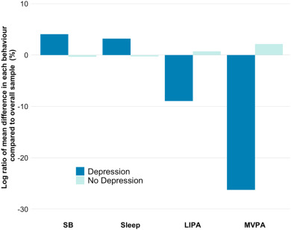
Fig. 1. Relative difference in time (expressed as a log-ratio difference) spent in each behaviour by depression status in comparison to the overall sample mean composition

Slide 28
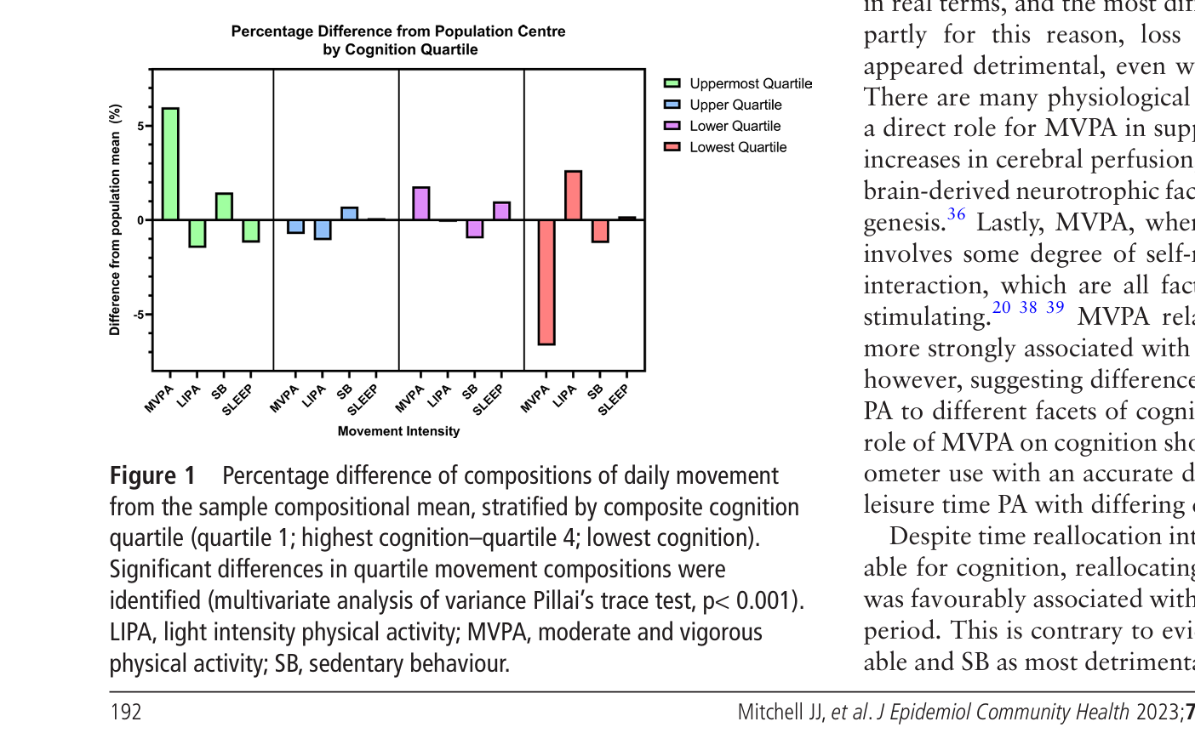

Slide 29
Prep
Apply closure constant
Visualisation
Modeling
Apply log-ratio transformation
Substitution
Adjust movement behaviours min-by-min
Model, re-pivot, model ...
Re-transform
Predict

Slide 30
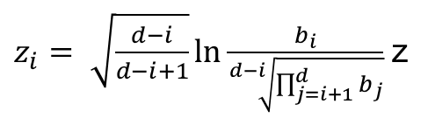
Isometric Log-ratio Transformation
ILR
$z_{i}= \sqrt{\frac{d−i}{d−i+1}}ln\frac{b_{i}}{\sqrt[d−i]{\prod_{j=i+1}^{d}{b_{j}}}}$ z

Slide 31
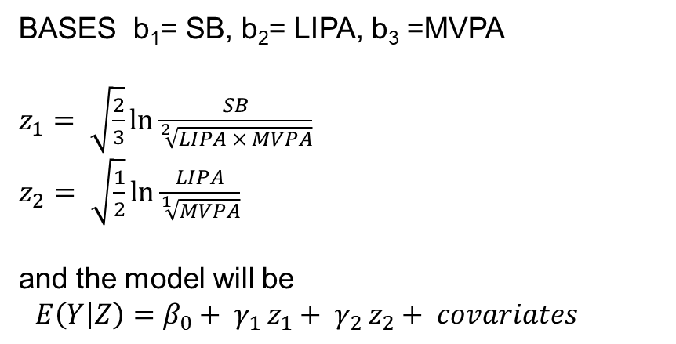
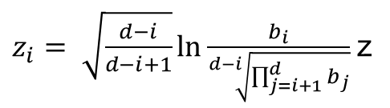
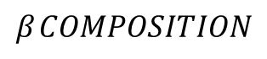
Regression with Isometric Log-ratio Coordinates “Nested relative parameters”
(ILR)
$z_{i}= \sqrt{\frac{d−i}{d−i+1}}ln\frac{b_{i}}{\sqrt[d−i]{\prod_{j=i+1}^{d}{b_{j}}}}$ z
Unlike other types of log-ratio transformations, any permutations/order of the ratios does not affect the parameter as a whole and thus doesn’t affect the rest of the regression equation.. But it changes its interpretation.
BASES b₁= SB, b₂= LIPA, b₃ =MVPA
$z_{1}= \sqrt{\frac{2}{3}}ln\frac{SB}{\sqrt[2]{LIPA × MVPA}}$
$z_{2}= \sqrt{\frac{1}{2}}ln\frac{LIPA}{\sqrt[1]{MVPA}}$
and the model will be
$E\left(Y | Z\right)=β_{0}+ γ_{1 }z_{1}+ γ_{2 }z_{2}+ covariates$
$$β_{ }COMPOSITION$$
[Cannot tolerate 0 in behaviours]

Slide 32

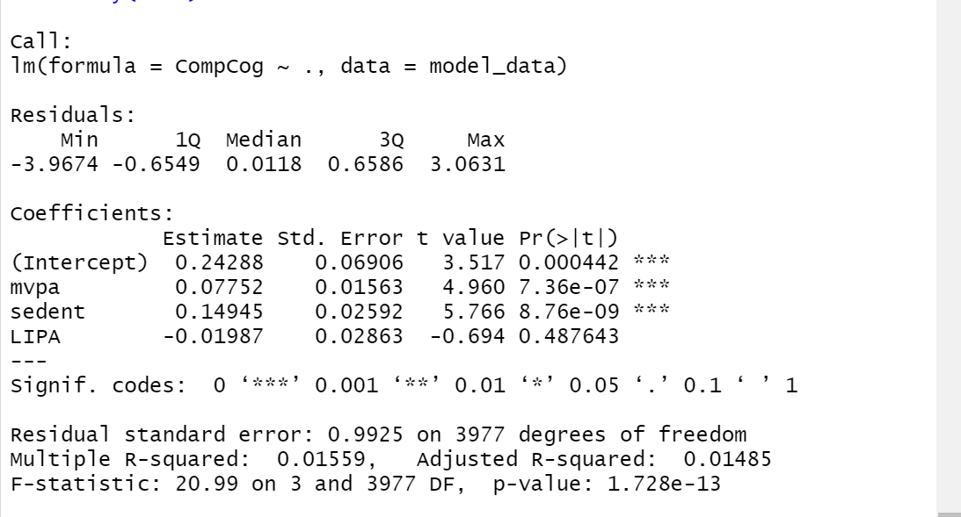



ILRs fitted in a regression model.
ilr 1 =
ilr 2 =
ilr 3 =
ILRs are “nested” parameters- the ILR pivot will not affect intercept.
Can perform isotemporal substitution using this regression equation.

Slide 33
“Permutations” or “Pivots” - Pivotal Decision Point in Exposure
ilr 1 =
ilr 2 =
ilr 3 =
ilr 1 =
ilr 2 =
ilr 3 =

Slide 34

ilr 1 =
+ ilr 2 =
For your regression analyses.. Report IL1 with every possible (6 possible) ILR1 pivots
… + Ilr3 + ilr4 + ilr5

Slide 35
ilr 1 =
+ ilr 2 =
For your regression analyses.. Report IL1 with every possible (6 possible) ILR1 pivots
… + Ilr3 + ilr4 + ilr5

Slide 36
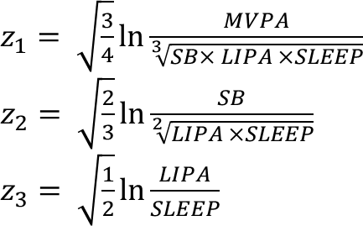
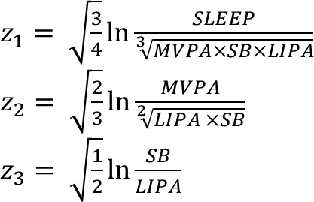
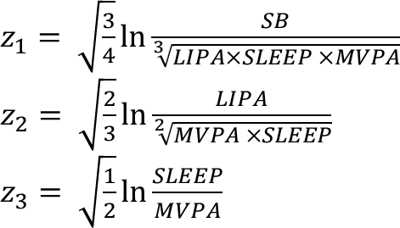
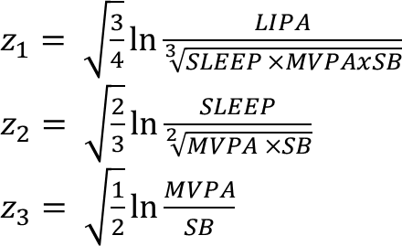

Slide 37


Slide 38
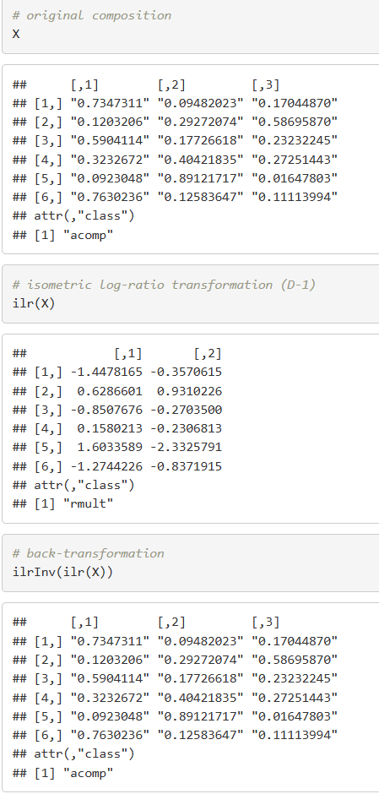
“Models were used to extract the predicted ILR coordinates which were back-transformed into geometric averages per time point.”
ilrInv() in ‘compositions’ R Package
Filzmoser, 2010

Slide 39
Back transformation
Isotemporal substitution

Slide 40
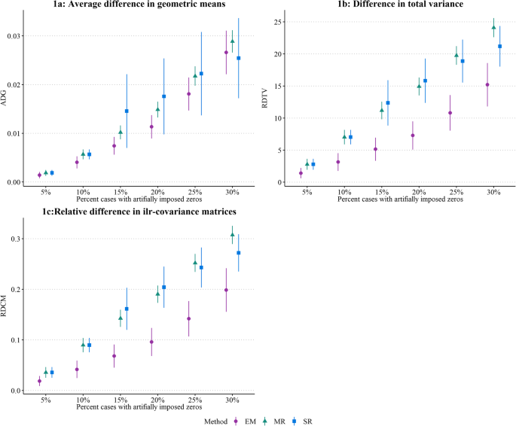
Zeroes
Simple approach: Apply fixed values
Multiplicative simple replacement
Log-ratio expectation-maximization (lrEM)
Algorithm
Rasmussen, Holtermann, 2020
multRepl: Multiplicative simple replacement in zCompositions: Treatment of Zeros, Left-Censored and Missing Values in Compositional Data Sets (rdrr.io)
lrEM: Log-ratio EM algorithm in zCompositions: Treatment of Zeros, Left-Censored and Missing Values in Compositional Data Sets (rdrr.io)

Slide 41
Prep
Apply closure constant
Visualisation
Modeling
Apply log-ratio transformation
Substitution
Adjust movement behaviours min-by-min
Model, re-pivot, model ...
Re-transform
Predict

Slide 42
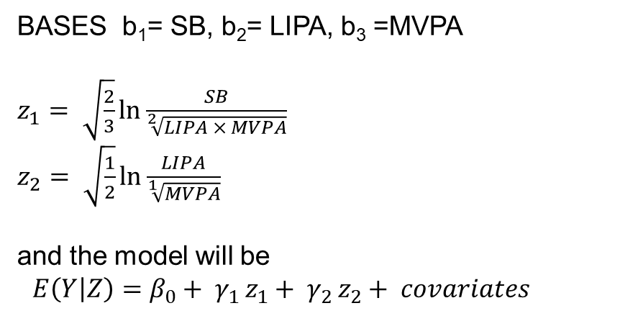
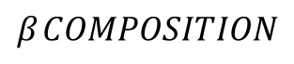
Predict on any model
Can’t amend compositions in their transformed state.
Find your reference composition (compositional centre/a referent group).
Add/subtract from two behaviours raw values.
Re-close
Re-transform
Predict
BASES b₁= SB, b₂= LIPA, b₃ =MVPA
$z_{1}= \sqrt{\frac{2}{3}}ln\frac{SB}{\sqrt[2]{LIPA × MVPA}}$
$z_{2}= \sqrt{\frac{1}{2}}ln\frac{LIPA}{\sqrt[1]{MVPA}}$
and the model will be
$E\left(Y | Z\right)=β_{0}+ γ_{1 }z_{1}+ γ_{2 }z_{2}+ covariates$
$$β_{ }COMPOSITION$$

Slide 43
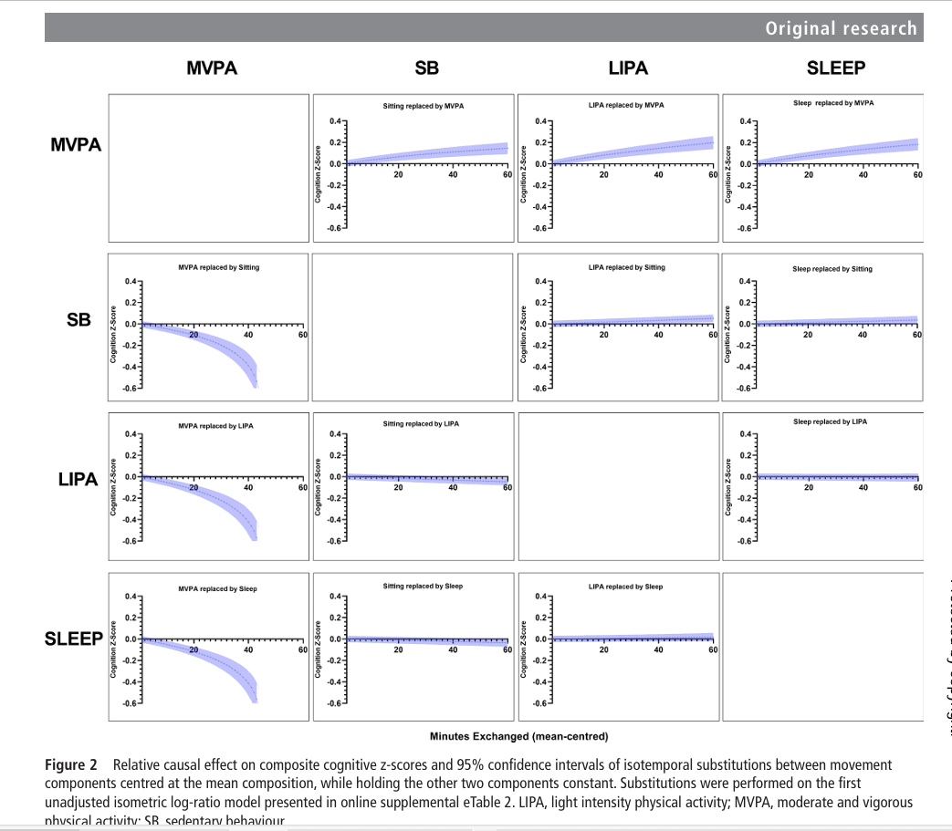
Isotemporal substitution
Take mean/reference composition of interest.
Generate new data with second/minute-by-minute substitution from 1 component to another
Apply predict on this data to your model (precedent: minimally-adjusted).
Can use bootstrapping to narrow confidence intervals in adjusted models.

Slide 44
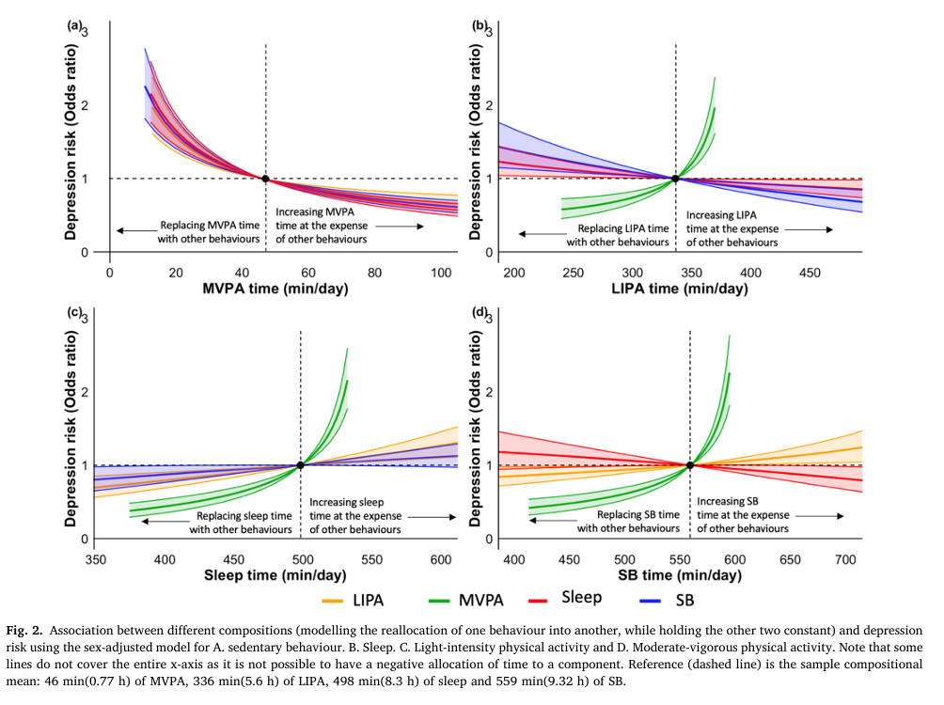
Substitution of ILR is permutation invariant
i.e. a model with any bases / permutation will return same prediction.
Specify significance by non-overall with the CI’s of the prediction for the mean composition.

Slide 45

Who did it better?
Substitution of ILR is permutation invariant
i.e. a model with any bases / permutation will return same prediction.
Specify significance by non-overall with the CI’s of the prediction for the mean composition.

Slide 46
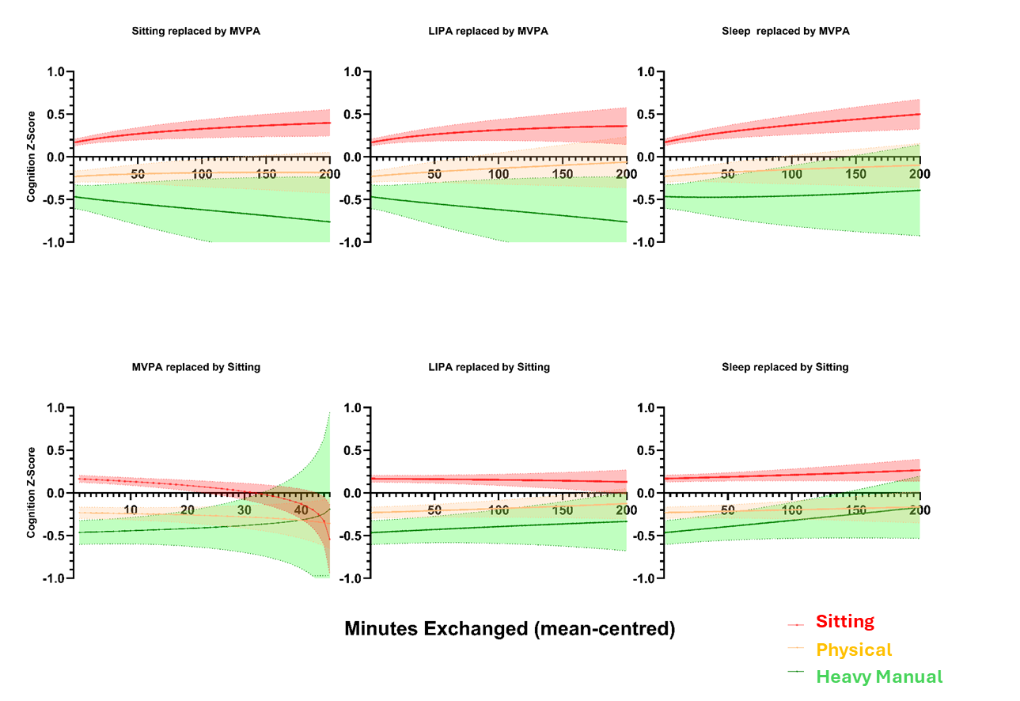
Subgroup analyses / Effect modification
Test interactions with all the components / pivots used.
Perform ITS on one of these models with the level set for the modifier / Stratify
Overlay.

Slide 47

New frontiers:
Compositions as outcomes.
Repeat measured compositions in multilevel models –
(..back-transform ILR coordinates to assess change in the mean composition over time)

Slide 48
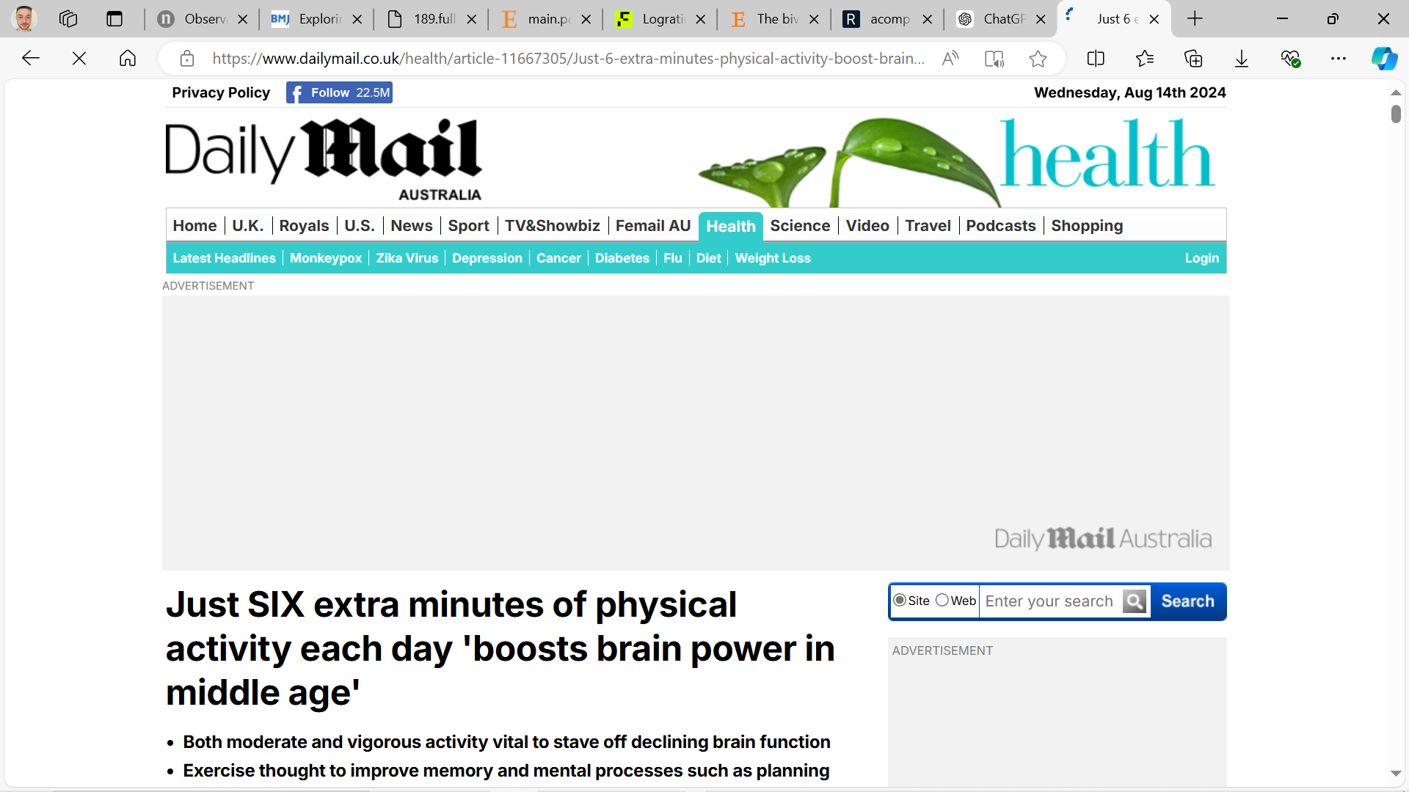


Reflections
Highly policy-relevant!
Be cautious with causal terminology
for this reason.

Slide 49
Reflections
Focus on methodological novelty and “methodological robustness compared to prior studies which do not account for the relative nature of daily time-use”.
It needs to be interpretable to a reviewer, so minimize technical aspects (ILR) etc.
Specify the ILR / substitution modeling approach in the methods and thereafter use ordinary, interpretable language thereafter. Where possible, avoid “components”, “substitution”, “bases”, “pivot”. Try: “reallocation” or better: “replacing X-minutes”

Slide 50
Reflections
Quiz – You are reviewer #2 and Angel sent you the following:
A) “When modelling the theoretical change in cancer risk from changes to the average daily composition, replacing just six minutes of MVPA with sleep was associated with a XX (YY-ZZ) reduction in risk”
B) “Isotemporal substitutions between components around the sample mean composition were conducted to predict the relative causal effect on cancer risk by substituting six minutes of MVPA to sleep whilst holding other components constant.”

Slide 51

Reflections
“When modelling the theoretical change in risk from changes to the average daily composition, replacing just six minutes of MVPA with sleep was associated with a XX (YY-ZZ) reduction in risk”
“Isotemporal substitutions between components around the sample mean composition were conducted to predict the relative causal effect on risk by substituting six minutes of MVPA to sleep whilst holding other components constant.”
Reviewer 2
Reviewer 2

Slide 52
Resources
Visualisation – CODA Pack
Code Sources - OpenCoda.com
Compositions package
Seb / ProPASS ILR rotation code
OSF | Lopes M.V.V., 2023ª - Code
epicoda/R at master · OxWearables/epicoda · GitHub
Seb / ProPASS ILR
Myself
Dumuid D, Pedišić Ž, Stanford TE, et al. The compositional isotemporal substitution model: A method for estimating changes in a health outcome for reallocation of time between sleep, physical activity and sedentary behaviour. Statistical Methods in Medical Research. 2019/03/01 2017;28(3):846-857. doi:10.1177/0962280217737805
Dumuid D, Pedišić Ž, Palarea-Albaladejo J, Martín-Fernández JA, Hron K, Olds T. Compositional Data Analysis in Time-Use Epidemiology: What, Why, How. Int J Environ Res Public Health. Mar 26 2020;17(7)doi:10.3390/ijerph17072220
Boogaart, K. and Tolosana-Delgado, R., n.d. Analyzing Compositional Data with R. Springer, Ed 2011

Slide 53
Summary
Respects the relative nature of compositional data in regression by performing ‘log-ratio transformations and comparing components proportions and not totals.
Relationship of components be plotted and explored in a D-1 simplex.
Isometric Log ratios is most easy, robust method.
Isotemporal substitution performed post-hoc on ILR model to paint a very policy-friendly message.
CODA’s easy to implement and hard to explain so try to make it reviewer friendly.

